Slide 1
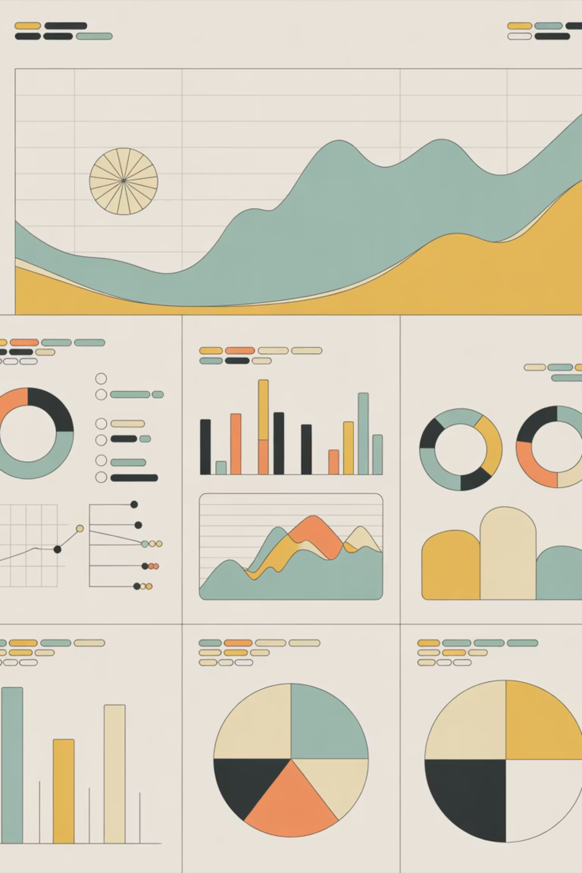
Customer Shopping Behavior Analysis
Uncovering insights from 3,900 purchases to drive strategic decisions

Slide 2

DATASET OVERVIEW
The Foundation
3,900
18
4
Total purchases analyzed
Key Features
Product Categories
Demographics, purchases, behavior metrics
Clothing, Accessories, Footwear, Outerwear

Slide 3
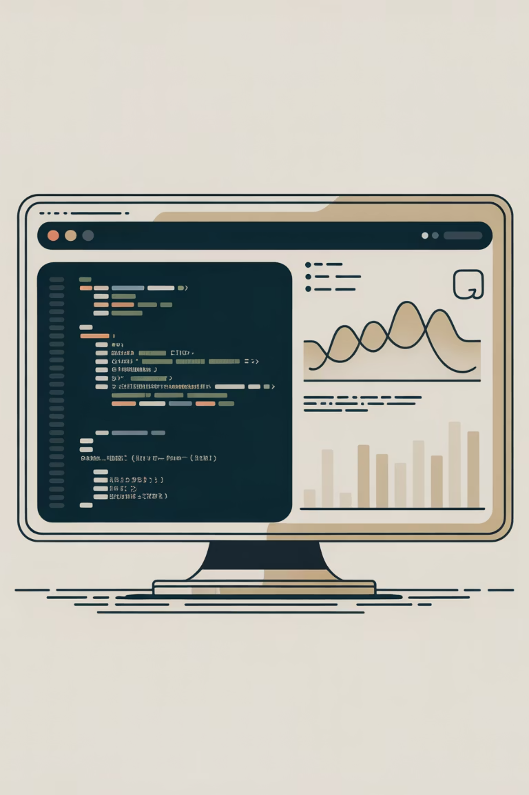
Data Preparation in Python
01
Data Loading & Exploration
Imported dataset, checked structure with pandas
02
Missing Data Handling
Imputed 37 missing review ratings using median
03
Feature Engineering
Created age groups and purchase frequency columns
04
Database Integration
Loaded cleaned data into MySQL for analysis

Slide 4

Key Customer Metrics
$59.76
3.75
25
Average Purchase
Review Rating
Previous Purchases
Customer satisfaction score
Typical transaction value
Average customer history

Slide 5
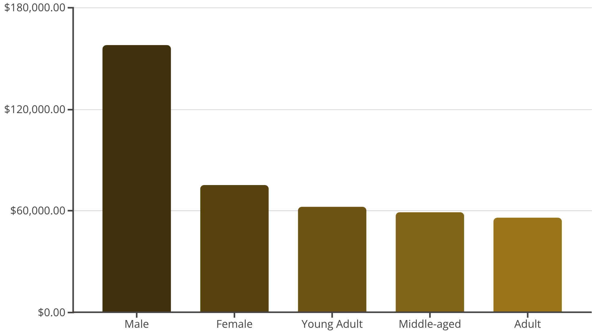

Revenue Insights
Gender & Age Patterns
Male customers generate 2x revenue compared to females. Young adults lead age group spending.
Target marketing efforts toward high-revenue segments

Slide 6



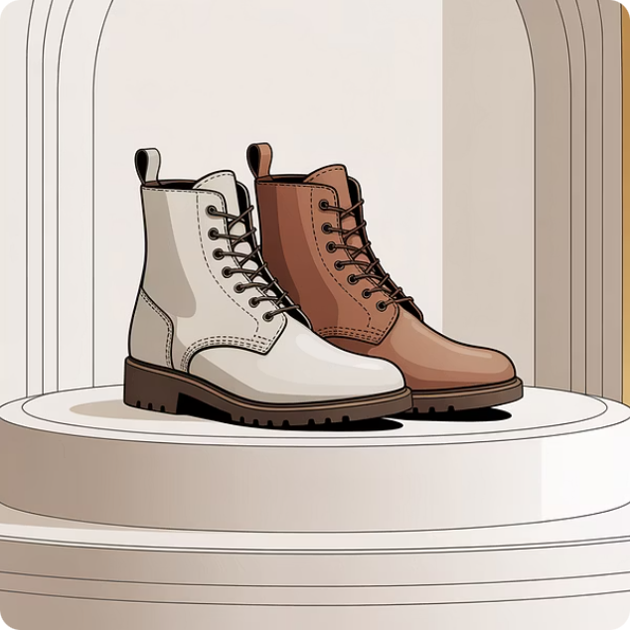
TOP PERFORMERS
Product Excellence
Gloves
Sandals
Boots
3.86 rating - Highest rated
3.84 rating - Customer favorite
3.82 rating - Strong performer

Slide 7

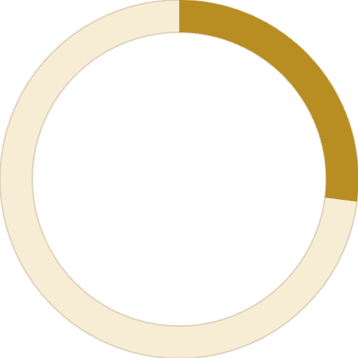

Customer Segmentation
Returning
701 customers
New
Loyal
83 customers
3,116 customers
Loyal customers dominate at 80% of base, presenting retention opportunity
Subscription Opportunity
73%
Massive untapped potential with 73% non-subscribers. Repeat buyers show strong subscription correlation.
27%
Subscribers
Non-Subscribers
1,053 active subscriptions
2,847 potential converts

Slide 8
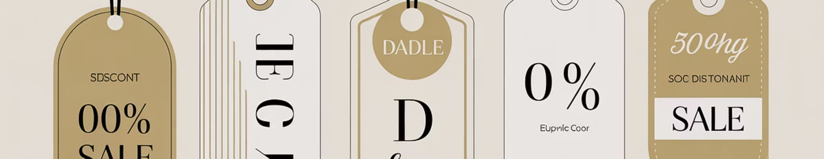
Discount Strategy Analysis
High-Value Discounters
Top Discount Products
Shipping Impact
839 customers used discounts but spent above average
Hats (50%), Sneakers (49.7%), Coats (49%)
Express shipping: $60.48 avg vs Standard: $58.46

Slide 9
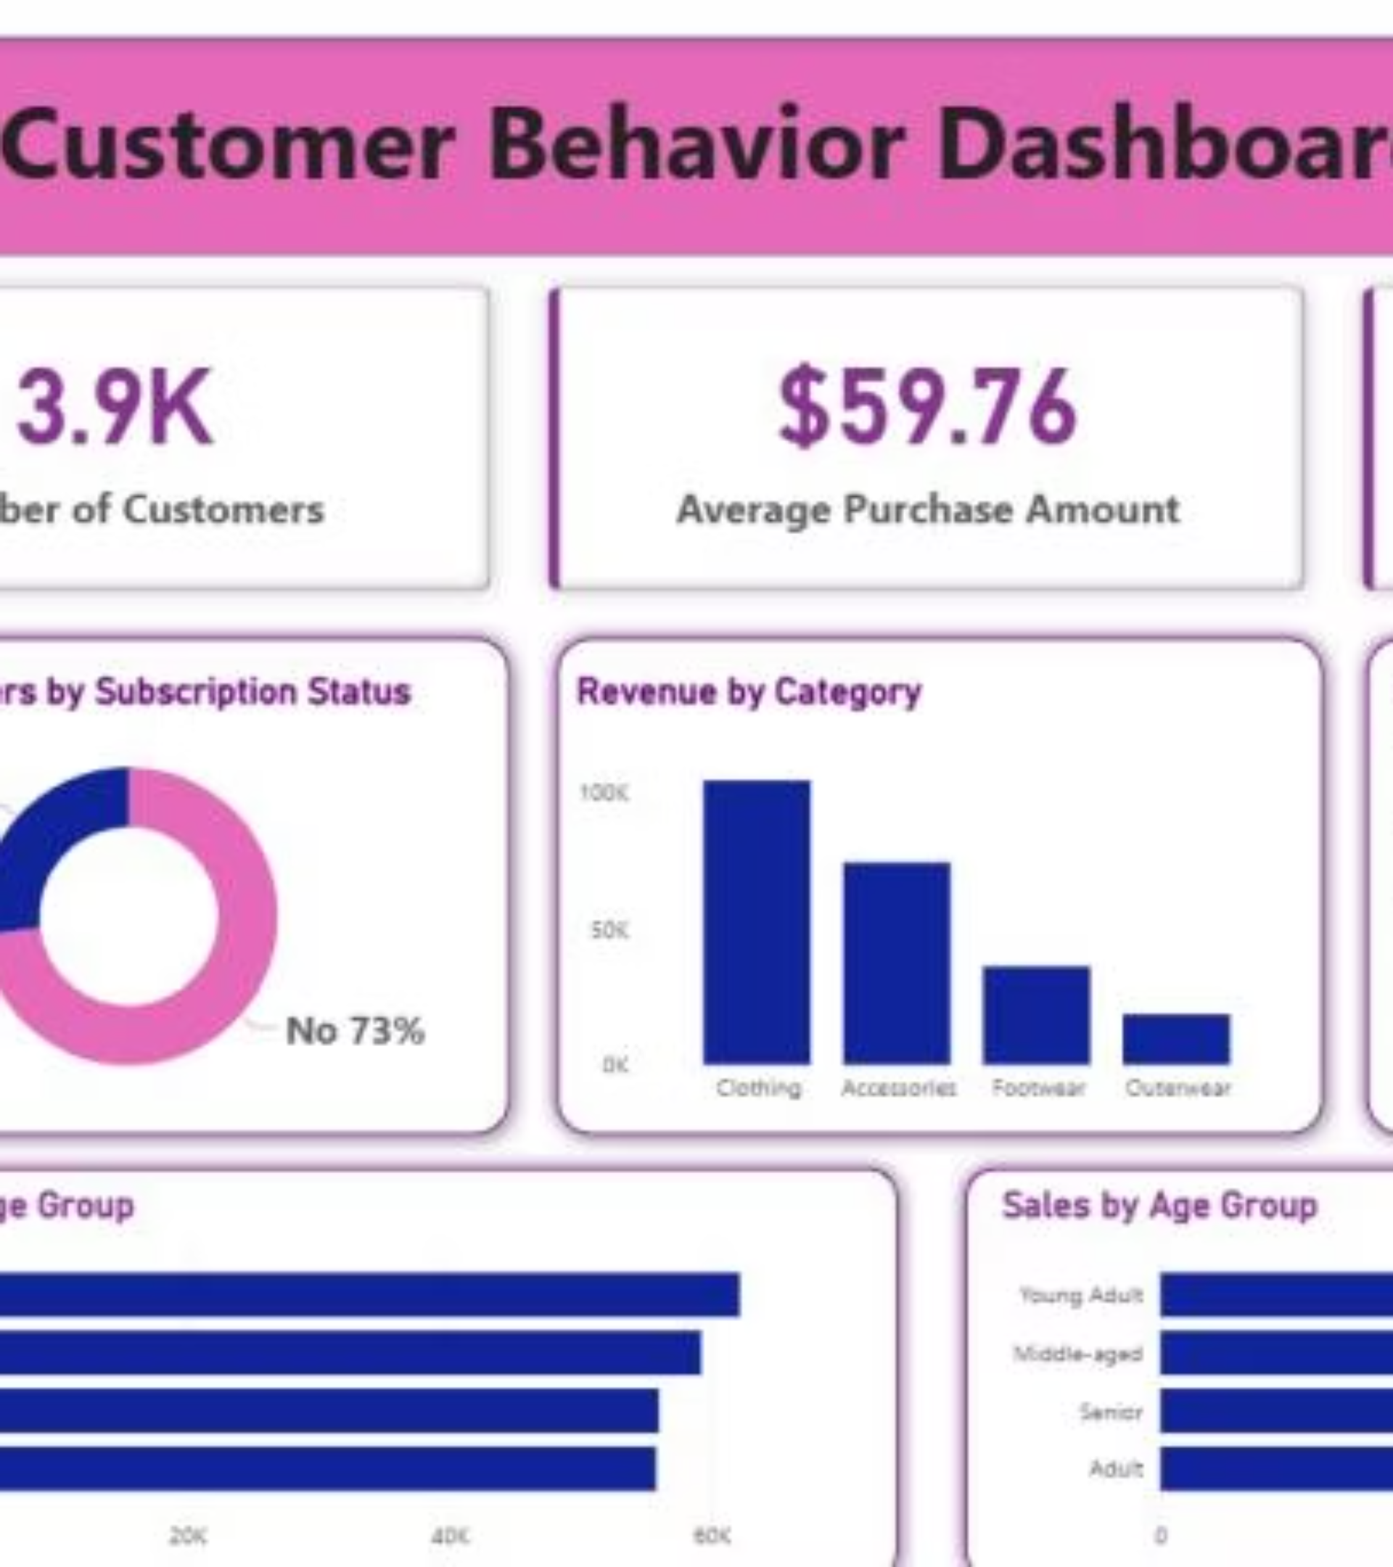
Power BI Dashboard
Interactive visualization enabling real-time exploration of customer behavior patterns

Slide 10





ACTION PLAN
Strategic Recommendations
Boost Subscriptions
Promote exclusive benefits to convert 73% non-subscribers
Loyalty Programs
Reward repeat buyers to strengthen loyal segment
Targeted Marketing
Focus on high-revenue age groups and express shippers

